Slide 1
2024
U.S. PRESIDENTIAL
ELECTION
U.S. Mission to France 2024

Slide 2
Video
Ambassador Denise Campbell Bauer with @gaby_hafner and @preetigills
at the Ambassador's Residence
September 2024
@fvapgov
@usembassyfrance

Slide 3
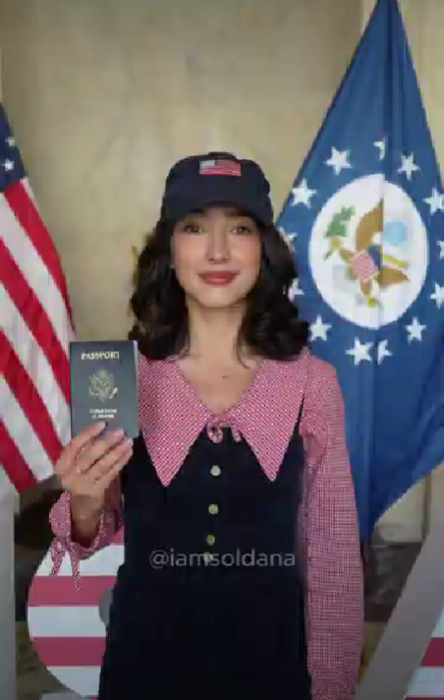
Video

Slide 4
2024 U.S. PRESIDENTIAL ELECTION
CONTENT
INTRODUCTION
THE PRESIDENT & THE VICE PRESIDENT
THE ELECTORATE
THE ELECTORAL PROCESS

Slide 5
2024 U.S. PRESIDENTIAL ELECTION
INTRODUCTION
Organization of the U.S. federal government

Slide 6
2024 U.S. PRESIDENTIAL ELECTION
The U.S. federal government is divided by the Constitution into three branches:
​
This ensures that no individual or group has too much power.

Slide 7
2024 U.S. PRESIDENTIAL ELECTION
Legislative Branch : Senate and House of Representatives
Powers:
Make Laws: Both chambers must agree
Ratify Treaties: The Senate approves international treaties.
Approve Presidential Appointments: The Senate confirms presidential nominees (judges, cabinet members, etc.).
Elections in 2024
House of Representatives:
All 435 seats on the ballot.
Every two years, voters elect new representatives for two-year terms.
Senate :
34 of 100 seats on the ballot
Staggered terms
​
Notes:
Elections in 2024:
House of Representatives:
All 435 seats on the ballot.
Every two years, voters elect new representatives for two-year terms.
Senate:
1/3 of seats (34/100) on the ballot
Senators serve six-year terms, and elections are staggered, meaning only a portion of the Senate is up for election every two years.
In 2023, in the Senate : 51 Democrats and 49 Republicans
VS House of Representatives : 222 Republicans and 213 Democrats

Slide 8
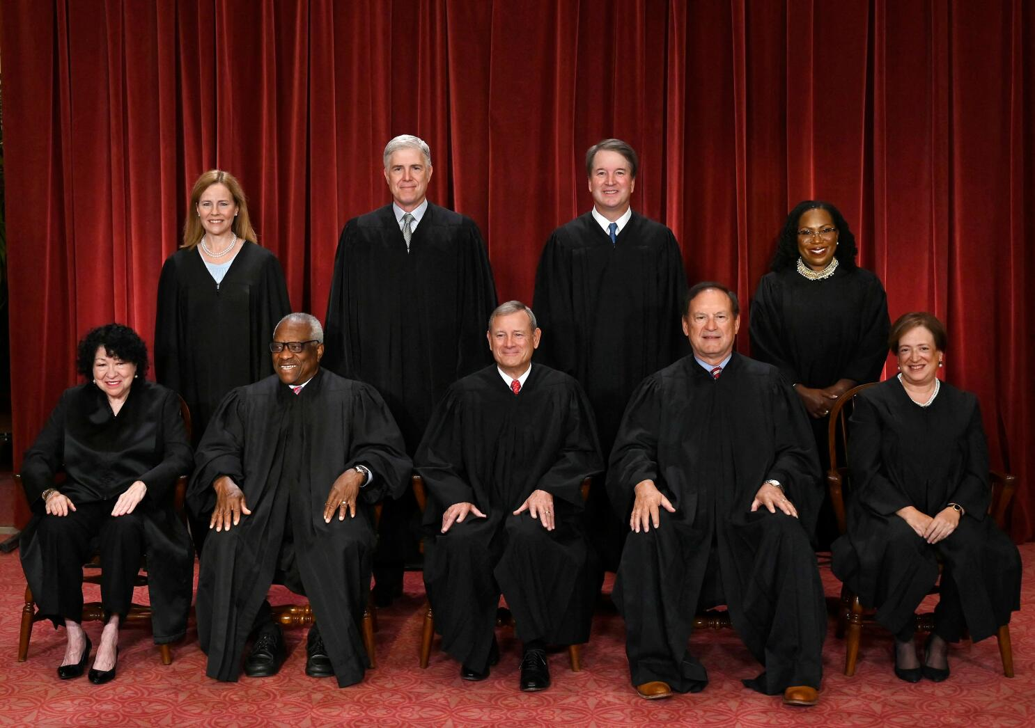
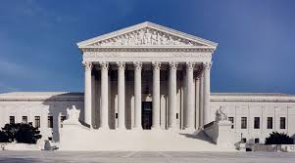
2024 U.S. PRESIDENTIAL ELECTION
Judicial Branch : The Supreme Court
Role :
Interpret Laws: Determines if laws are constitutional.
Set Legal Precedents: Their rulings guide future decisions.
Key Features:
Supreme Court: The highest court in the U.S., with 9 justices
Life-Long Appointments: Judges, including Supreme Court Justices, serve for life.
No Elections: Judges are appointed by the President and confirmed by the Senate.
The Supreme Court 2024
The Supreme Court Building, DC

Slide 9
THE PRESIDENT &
THE VICE PRESIDENT
The Executive Branch

Slide 10
Who can become President of the U.S. ?
Three Requirements to Run for U.S. President :
(Article II, Section 1, Clause 5 of the Constitution)
Natural-born citizen:
Must be born in the U.S. or to U.S. citizen parents
Cannot be a citizen through naturalization
At least 35 years old
Resident of the United States for at least 14 years
The President can only serve ​two 4-year terms ​
22nd Amendment of the Constitution 1947

Slide 11
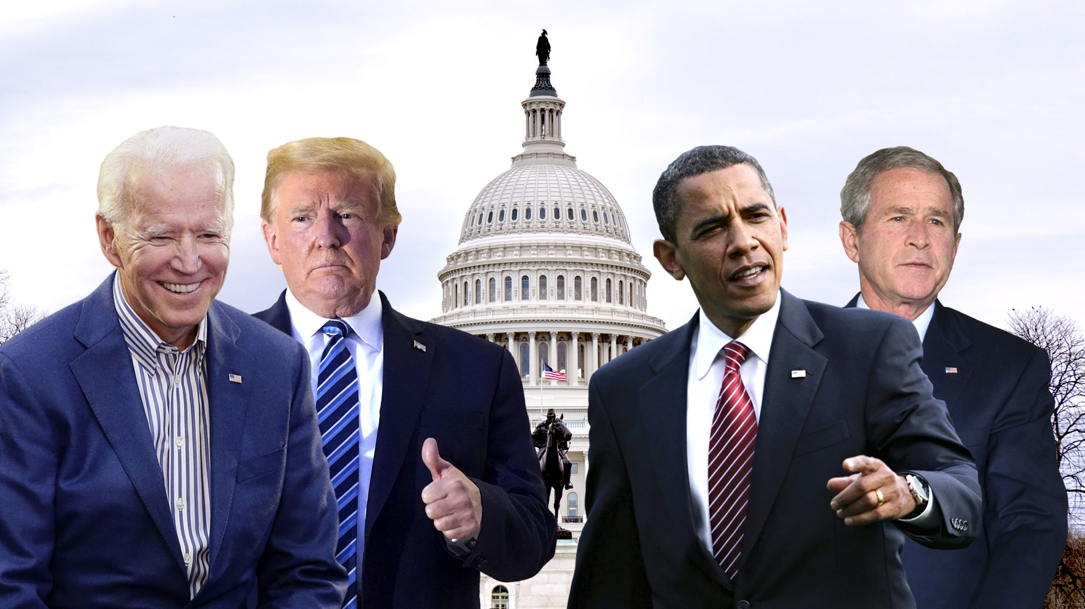
What are the main roles of the President ?
Joe Biden (2021-2025)
Donald Trump (2017-2021)
Barack Obama (2009-2017)
George W. Bush (2001-2009)
​
Head of the Executive branch​
​
Commander-in-Chief of the armed forces
​
Appoints high-ranking officials of executive agencies and members of the federal judiciary​
Signs treaties with foreign governments​
​
Signs or vetoes legislation passed by Congress

Slide 12
What are the main roles of the Vice President ?
​
Stands for election with the President
Presidential Ticket​
Is second in the presidential line of succession
Replace the President in the event of the latter's death, resignation, or impeachment​
Is the President of the Senate​
Operates within both the executive and legislative branches of government
Current Vice President: Kamala Harris ​
Running for the Democratic Party

Slide 13
2024 U.S. PRESIDENTIAL ELECTION
THE ELECTORATE

Slide 14
Who can vote ?
You can vote in U.S. federal, state, and local elections if you:​
Are a U.S. citizen (some areas allow non-citizens to vote in local elections only)​
Meet your state’s residency requirements
Are 18 years old ​
Are registered to vote by your state's voter registration deadline
​
Notes:
You can vote in U.S. federal, state, and local elections if you:​
Are a U.S. citizen (some areas allow non-citizens to vote in local elections only)​
Meet your state’s residency requirements
Are 18 years old ​
Are registered to vote by your state's voter registration deadline

Slide 15
Who cannot vote ?
Non-citizens, including permanent legal residents
People convicted of a felony or currently serving time (rules vary by state)
People who have a mental disability (rules vary by state)
U.S. citizens residing in U.S. territories cannot vote for President in the general election
Notes:
Non-citizens, including permanent legal residents, cannot vote in federal, state, and most local elections
Some people cannot vote after being convicted of a felony or if they are currently serving time for other types of crimes (rules vary by state)
Some people who have a mental disability may not be able to vote (rules vary by state)
U.S. citizens residing in U.S. territories cannot vote for President in the general election

Slide 16
2024 U.S. PRESIDENTIAL ELECTION
THE ELECTORAL PROCESS
(BEFORE THE ELECTION)

Slide 17
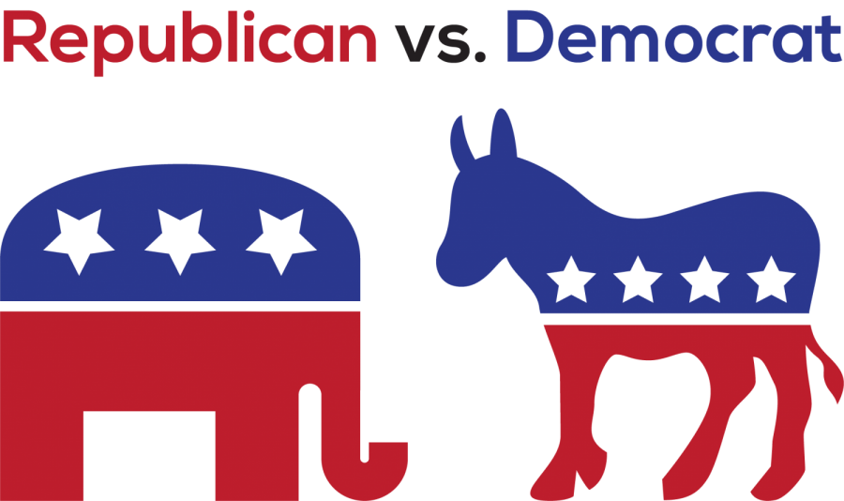
2024 U.S. PRESIDENTIAL ELECTION
A two-party system:
Two main parties since the Civil War :
​
There is no Constitutional obligation to have only two parties and others do exist:
Green Party:
Jill Stein
Libertarian Party:
Chase Oliver
The Republican Party:
Donald Trump
The Democratic Party :
Kamala Harris

Slide 18
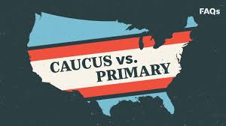
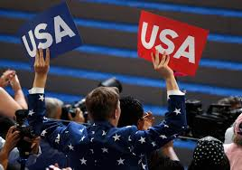
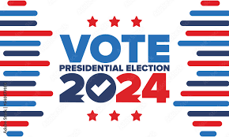
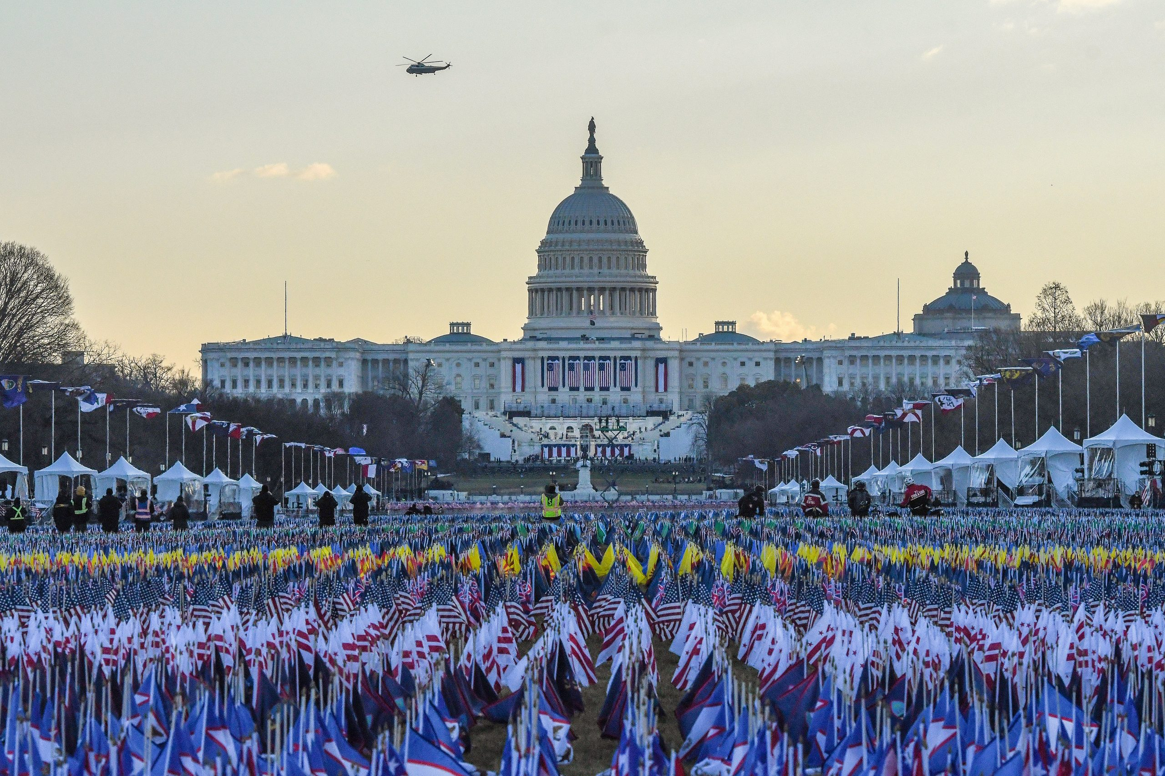
Overview of the presidential election process
Candidates register with the Federal Election Commission and announce their intention to run for president.
(Spring 2023)
Primary and caucus debates take place.
(January to June 2024)
Parties hold nominating conventions to choose their presidential candidates
(RNC July ; DNC August)
Electors cast their votes in the Electoral College
(December 17th, 2024)
&
Congress counts the votes
(January 6th, 2025)
Election Day ,
the "first Tuesday after the first Monday" of November
(November 5th, 2024)
Presidential Inauguration Day
(January 20th, 2025)
Notes:
*Campaign Trail : candidates participate in presidential debates, national political conventions, rallies etc

Slide 19
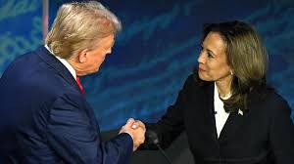
The Campaign Trail
First presidential debate
June 27, 2024
Former President Donald Trump's
first general election campaign event
in Pennsylvania, April 2024
Vice President Kamala Harris'
first campaign event
at West Allis School (WI), July, 2024
Canvassing
Last presidential debate, September 2024
Ads and posters
Notes:
*"canvassing" is the process of reaching out to voters—through door-to-door visits, phone calls, or surveys—to gather information, promote a candidate, or persuade them to vote a certain way.

Slide 20
Primaries and Caucuses (1/2)
What is the Difference Between Primaries and Caucuses?
Primaries:
Run By: State and local governments
How It Works: Voters cast secret ballots at polling stations, just like in general elections
Purpose: Choose party nominees for the presidential election.
Caucuses:
Run By: Political parties
How It Works: Voters gather in person, discuss candidates, and publicly show support by grouping together.
Purpose: Select party nominees for the presidential election through public discussion and voting.
Notes:
What is the difference between the two?
​U.S. states hold either a primary election or caucuses, part of which is to choose the state's top Republican and Democrat presidential candidates.
Caucuses are elections run by political parties
Primaries are run by state and local governments
At the end, the results of the vote is taken into account to award delegates to the winners.
Both primaries and caucuses can be “open,” “closed,” or a mix of the two.
Primary elections and caucuses
differ in how they are organized
and who participates. And rates
of participation differ widely.
Primaries: State governments fund and conduct
primary elections much as they would any election:
Voters go to a polling place, vote and leave. Voting
is anonymous and quickly accomplished. Some states
hold “closed” primaries in which only declared party
members can participate. For example, only registered
Democrats can vote in a closed Democratic primary.
In an open primary, all voters can participate, regardless of their party affiliation or lack of affiliation.
Caucuses: State political parties organize
caucuses, in which faithful party members speak
openly on behalf of the candidates they support for the
party nomination. They are communal events in which
participants vote publicly. Caucuses tend to favor candidates who have dedicated and organized supporters who
can use the caucus to elect convention delegates pledged
to their favored presidential candidate. Caucus participants
also identify and prioritize issues they want to include
in the state or national party platform. Participation in
a caucus requires a high level of political engagement
and time. Consequently, caucuses tend to attract
fewer participants than primaries

Slide 21
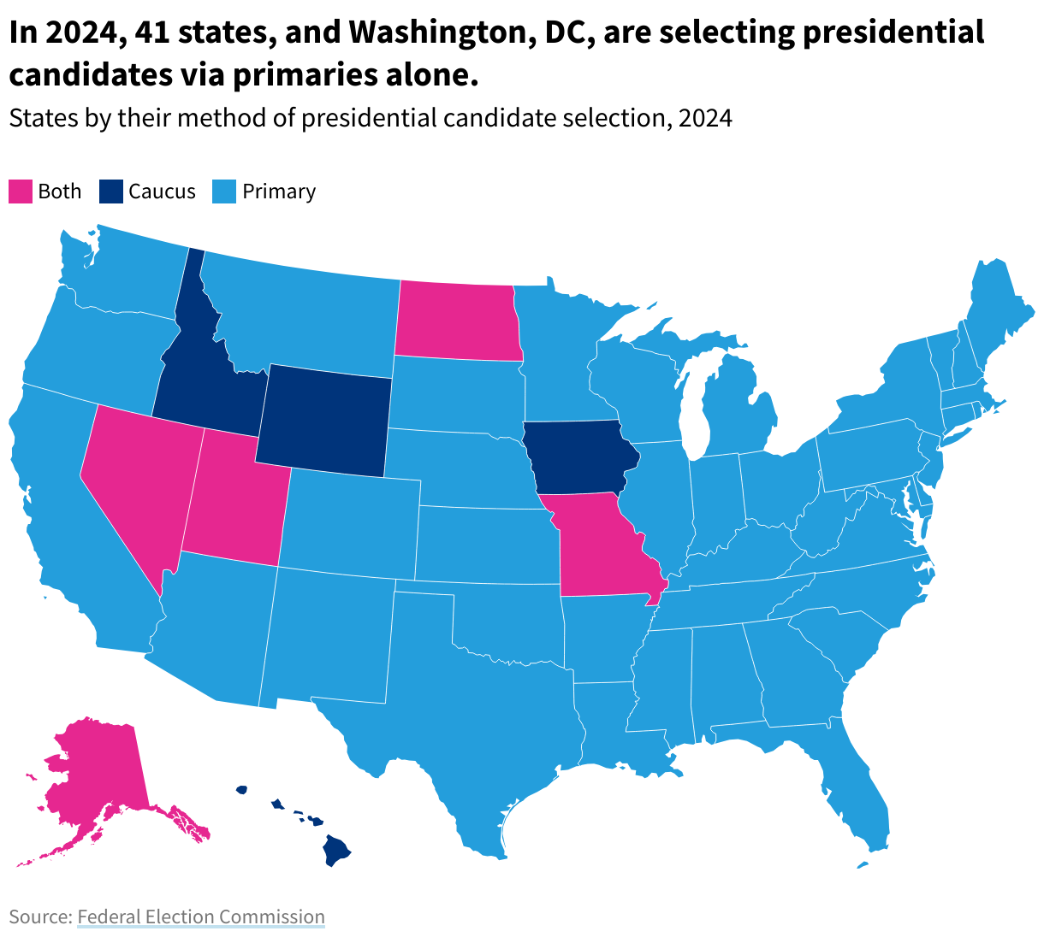
Primaries and Caucuses (2/2)
Notes:
What is the difference between the two?
​U.S. states hold either a primary election or caucuses, part of which is to choose the state's top Republican and Democrat presidential candidates.
Caucuses are elections run by political parties
Primaries are run by state and local governments
At the end, the results of the vote is taken into account to award delegates to the winners.
Both primaries and caucuses can be “open,” “closed,” or a mix of the two.
Primary elections and caucuses
differ in how they are organized
and who participates. And rates
of participation differ widely.
Primaries: State governments fund and conduct
primary elections much as they would any election:
Voters go to a polling place, vote and leave. Voting
is anonymous and quickly accomplished. Some states
hold “closed” primaries in which only declared party
members can participate. For example, only registered
Democrats can vote in a closed Democratic primary.
In an open primary, all voters can participate, regardless of their party affiliation or lack of affiliation.
Caucuses: State political parties organize
caucuses, in which faithful party members speak
openly on behalf of the candidates they support for the
party nomination. They are communal events in which
participants vote publicly. Caucuses tend to favor candidates who have dedicated and organized supporters who
can use the caucus to elect convention delegates pledged
to their favored presidential candidate. Caucus participants
also identify and prioritize issues they want to include
in the state or national party platform. Participation in
a caucus requires a high level of political engagement
and time. Consequently, caucuses tend to attract
fewer participants than primaries

Slide 22
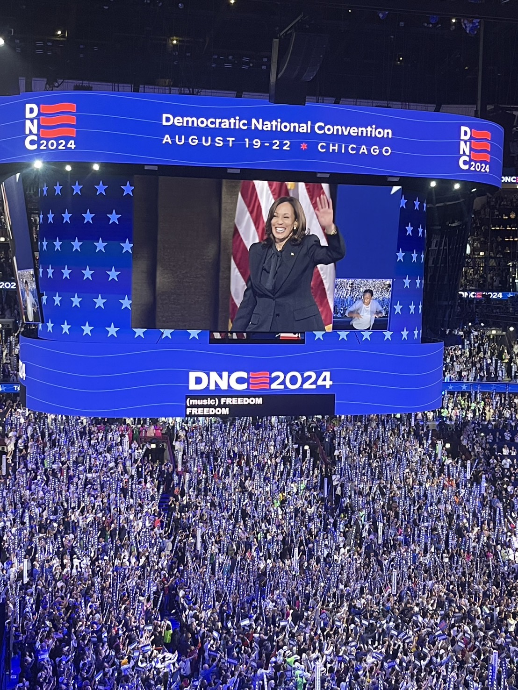
National political conventions (1/2)
Delegates gather and nominate presidential candidate
Presidential nominee announces VP pick
Presidential campaign begins for General Election
Republican Convention :
July 15-18, Milwaukee, WI
Democratic Convention :
August 19-22, Chicago, IL
Notes:
National political conventions are held every four years in the months leading up to the U.S. presidential election.
The national conventions' purpose is for the delegates to officially nominate their candidate to run for President.
At the convention, the presidential nominee officially announces their selection of a vice-presidential running mate.
For 2024, the Democratic Convention is scheduled for August 19-22 in Chicago, IL.
The Republican Convention occurred July 15-18 in Milwaukee, WI.
National Political Conventions: These conventions are held every four years before the presidential election.
Democratic Convention: Scheduled for August 19-22, 2024, in Chicago, IL.
Republican Convention: Took place July 15-18, 2024, in Milwaukee, WI.
Delegates Gather and Nominate: Party delegates meet to officially nominate their candidate for president.
Presidential Nominee Announces VP Pick: The selected presidential candidate announces their choice for vice-presidential running mate.
Presidential Campaign Begins: The nominated candidate starts their campaign for the general election.

Slide 23
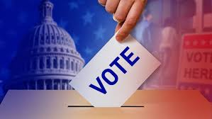
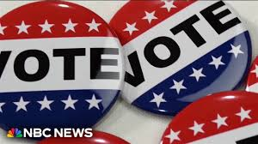
National political conventions (2/2)
Delegates
Role : Casting votes to select the party's presidential and vice-presidential nominees
Two types :
Pledged delegates :
Selected through primaries and caucuses
Committed to a specific candidate based on the results of those events
Unpledged or Automatic Delegates :
Party leaders and elected officials not bound by primary or caucus results
Free to support any candidate
Notes:
A delegate is a person chosen to represent a group of people, typically at a political party's national convention.
Delegates are responsible for casting votes on behalf of the party members from their state or territory to select the party's presidential and vice-presidential nominees. There are two main types of delegates:
Pledged Delegates: These delegates are selected through primaries and caucuses and are committed to supporting a specific candidate based on the results of those events
Unpledged or Automatic Delegates: These delegates, often called superdelegates in the Democratic Party, include party leaders and elected officials who are not bound by primary or caucus results and can support any candidate they choose
Constitution : The colloquially-named Electoral College arises from Article II, Section 1, Clauses 2 and 3, which state that:
"Each State shall appoint, in such Manner as the Legislature thereof may direct, a Number of Electors, equal to the whole Number of Senators and Representatives to which the State may be entitled in the Congress; but no Senator or Representative, or person holding an Office of Trust or Profit under the United States shall be appointed an Elector.

Slide 24
2024 U.S. PRESIDENTIAL ELECTION
THE ELECTORAL PROCESS
(DURING & AFTER THE ELECTION)

Slide 25
Election Day (1/2)
Who Can Vote?
All registered citizens, even if they didn't vote in primaries.
Vote for any candidate, regardless of party registration or past votes.
When to Vote?
Election Day: First Tuesday after the first Monday in November (11/5/24)
Where to vote?
Polling Places: Assigned location (schools, community centers, or other public buildings).
Extended Voting Options: Absentee, mail-in, and early voting
Notes:
1) In the presidential general election, citizens who are registered can:​
Vote even if they did not vote in their state’s primary elections
Vote for any presidential candidate, regardless of the party they are registered with or who they voted for in the past
2) Most people vote on Election Day, which is the first Tuesday after the first Monday in November (11/5/24)
3) Depending on where you live, the voting period may be extended to include absentee ballots, mail-in ballots, and early voting. The early voting period depends on your state and can go from mid-September to November.

Slide 26
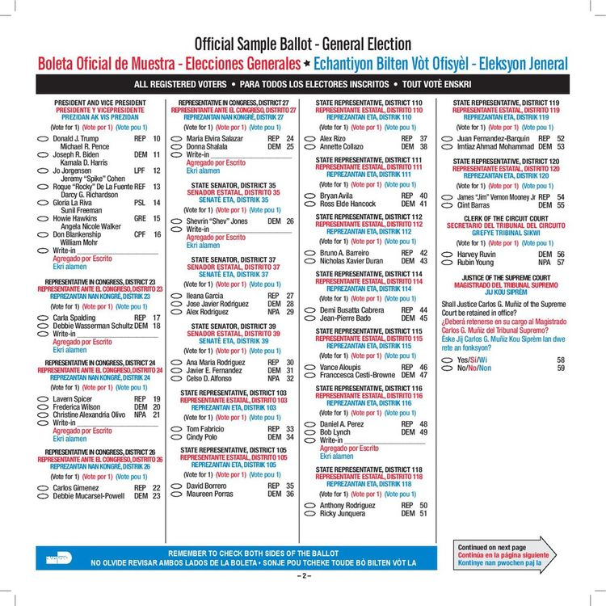
Election Day (2/2)
​
What’s decided on Election Day ?
Presidential election
Congress:
34 of 100 Senate seats
435 House of Representatives seats are up for election​
State & Local:
12 gubernatorial races (governors’ elections)​
Judges, local referendums…
2020 Miami-Dade County Ballot, Florida
Notes:
On Election Day, voters will not only determine the outcome of the presidential election but also play a crucial role in shaping Congress, the judicial branch, state governments and other local elections: ​

Slide 27
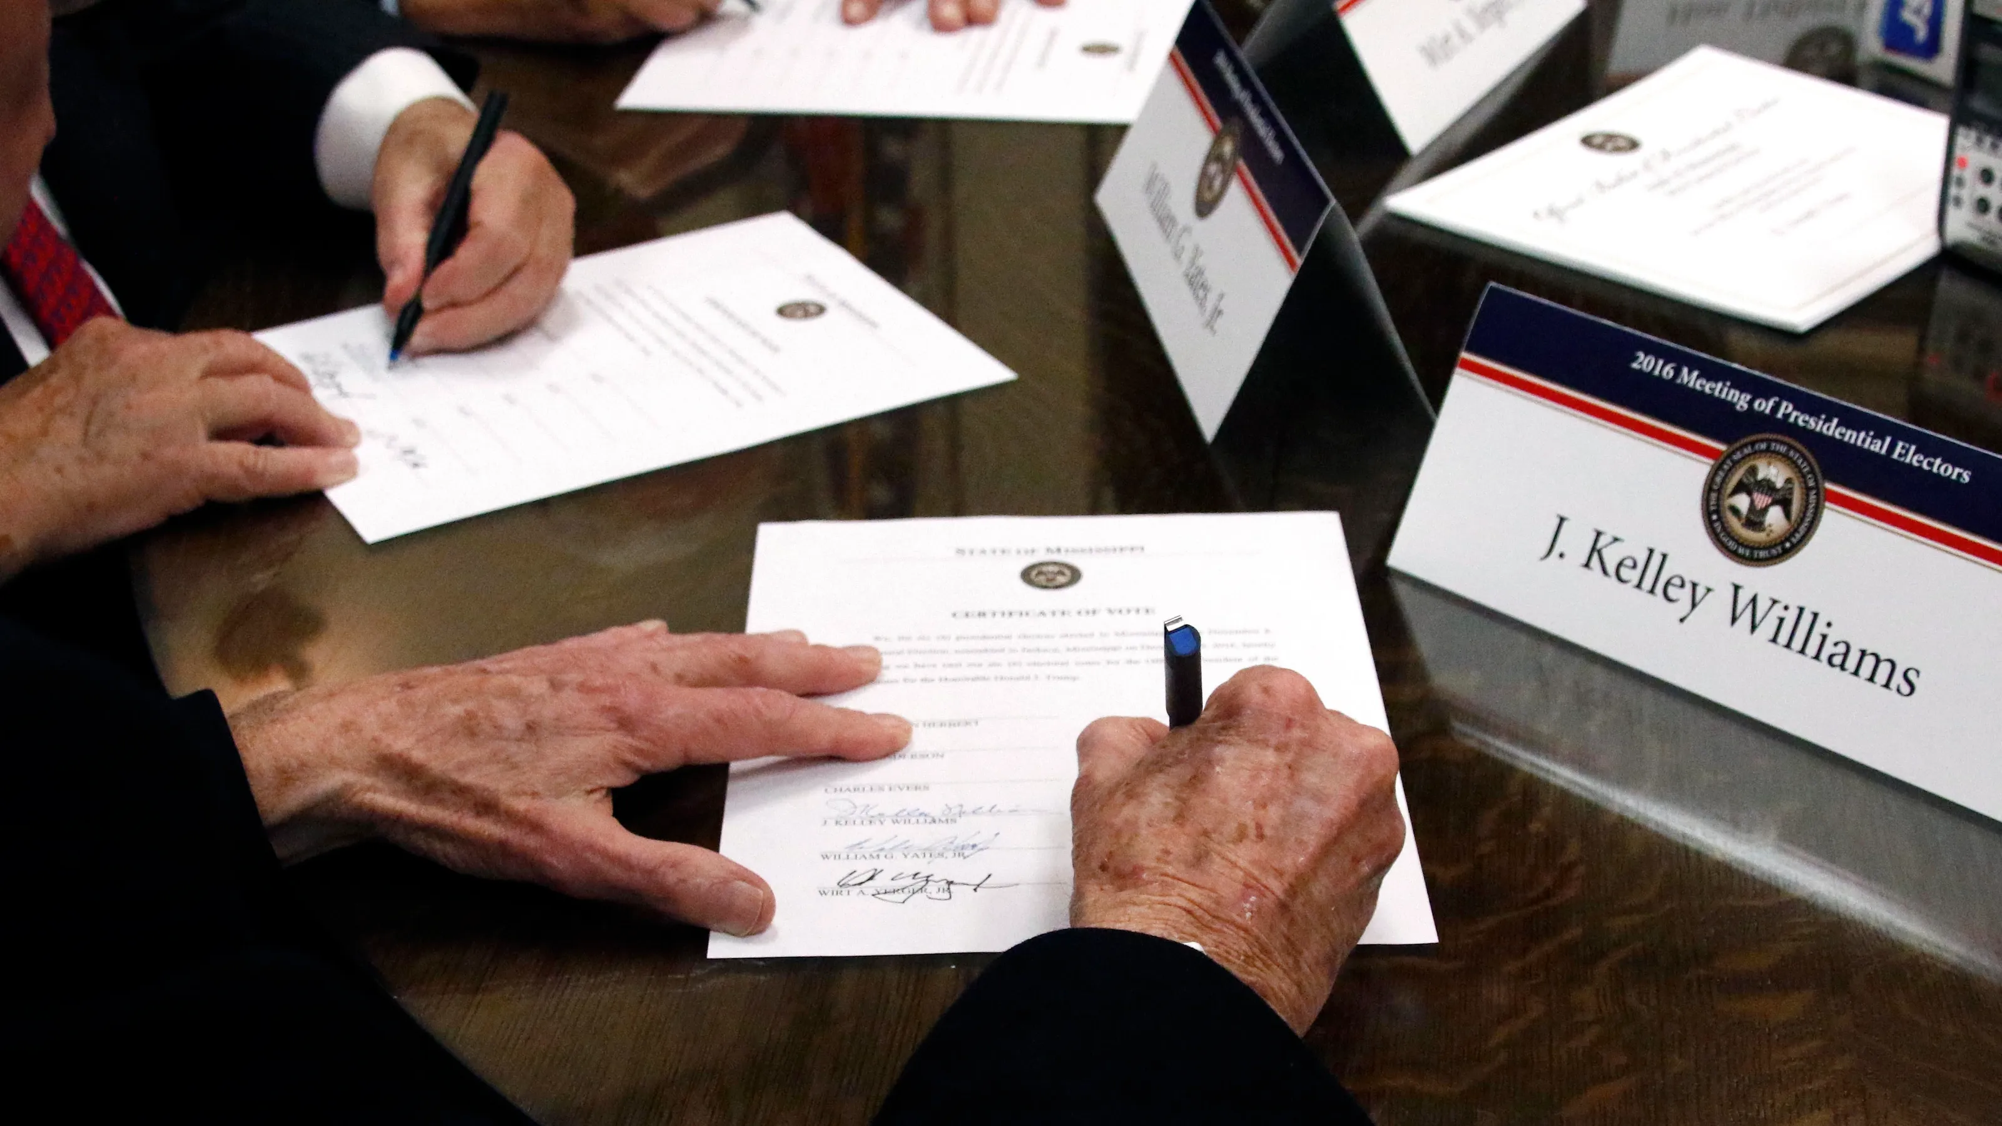
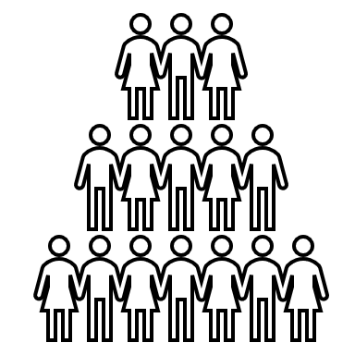
The Electoral College : what is it ? (1/3)
The president and vice president are not chosen directly by the popular vote, instead, they are selected through the Electoral College system.
Established by the U.S. Constitution (1787), Art II, Section 1,
Designed to balance influence between small and large states
Not a body but a process:
Selection of electors
Electors vote for President and Vice President
Congress counts the electoral votes
Voters
Electors
Congress
President
Notes:
The Electoral College is not a physical place.
It is a process which includes the:​
Selection of electors​
Meeting of electors who cast votes for the President and Vice President​
Counting of the electors’ votes by Congress​

Slide 28
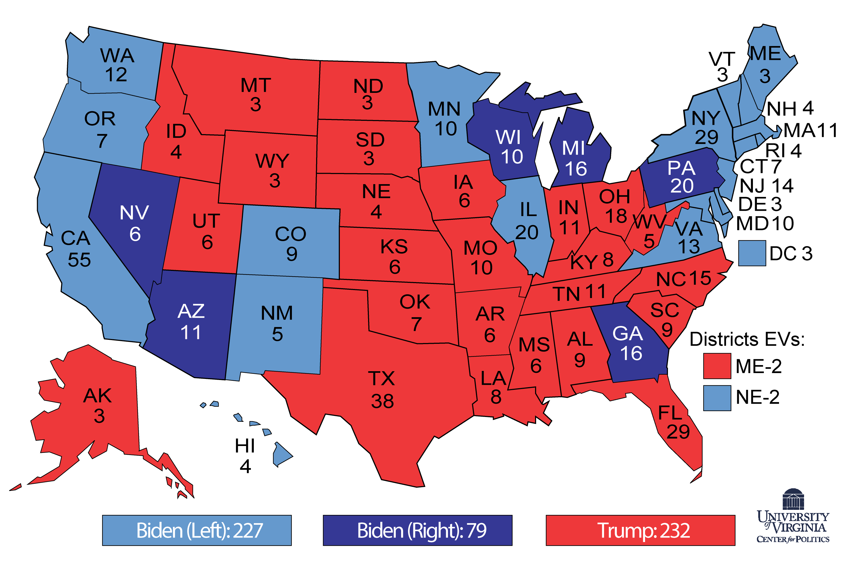
The Electoral College (2/3)
Red states, blue states, purple/swing states
2020 U.S. Presidential Election
Democratic Party = blue states Republican Party = red states
States where the vote fluctuates = purple states or swing states
Notes:
Starting with the 2000 United States presidential election, the terms "red state" and "blue state" have referred to U.S. states whose voters vote predominantly for one party:

Slide 29
The Electoral College : how does it work ? (3/3)
After you cast your ballot-> Statewide tally
Winner-Takes-All: 48 states + D.C. give all electoral votes to the state's winner.
Maine and Nebraska split electoral votes based on results
270 Electoral Votes Needed to win (majority of 538).
Most results projected on Election Night in November;
official vote in mid-December when the electors meet in their states.
Elector Obligations:
Most electors follow the state’s popular vote.
Some states penalize "faithless electors" (those who don't).
Notes:
After you cast your ballot for President, your vote goes to a statewide tally. In 48 states and Washington, D.C., the winner gets all the electoral votes for that state. Maine and Nebraska assign their electors using a proportional system. A candidate needs the vote of at least 270 electors—more than half of all electors—to win the presidential election. In most cases, a projected winner is announced on election night in November after you vote. But the actual Electoral College vote takes place in mid-December when the electors meet in their states. While the Constitution does not require electors to vote for the candidate chosen by their state's popular vote, some states do. The rare elector who votes for someone else may be fined, disqualified and replaced by a substitute elector, or potentially even prosecuted by their state.

Slide 30
Inauguration Day : January 20, 2025
The U.S. Capitol building, Washington, D.C.
Around noon, the president-elect recites the following oath in accordance with Article II, Section I of the U.S. Constitution:
I do solemnly swear that I will faithfully execute the Office of President of the United States, and will to the best of my ability, preserve, protect and defend the Constitution of the United States.
Notes:
Note historiaue ; pourquoi 20

Slide 31
Thank you !
Any questions?

